Slide 1
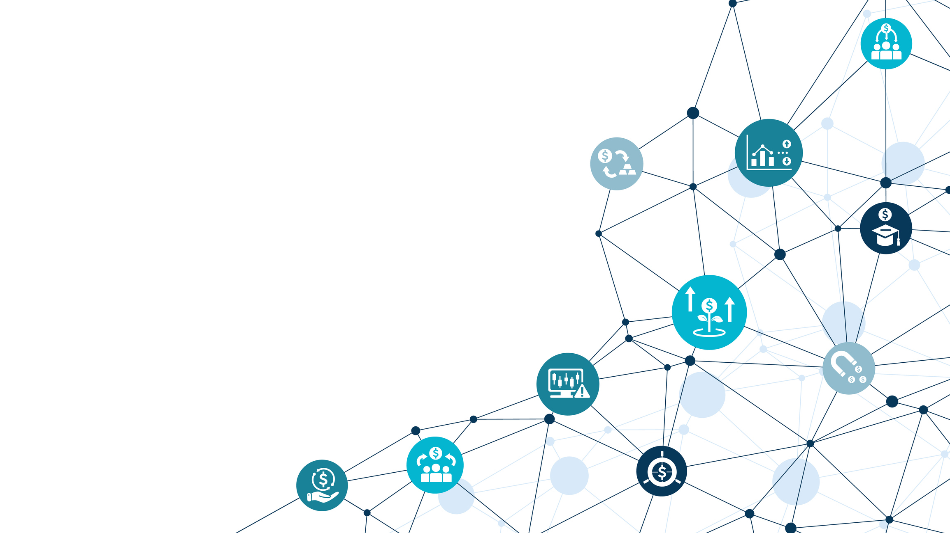
Digital
Marketing
Strategy
Notes:
Add an image

Slide 2
After the emergence of e-commerce and the internet, consumer behavior drastically changed the fundamentals of engagement, including
HOW TO
ACQUIRE
new customers
ENGAGE
with current customers
MEASURE
the effectiveness of marketing spend
CREATE
and create and capture value
Notes:
Lighter blue or cream

Slide 3
The four components of a successful marketing plan include
Goals/
Objectives
Target Audience
Value Proposition
Metrics
The broader outcomes we hope to achieve, e.g., increase brand awareness, double sales
The group of consumers that will be the focus of the marketing campaign
The key differentiation of the SEC’s product or service; the reason why consumers would consider us instead of other agencies or private companies
Key performance indicators
that track the success of marketing efforts

Slide 4
The customer journey is often represented by a visual schematic known as the marketing funnel.
Awareness
Consideration
Conversion
AWARENESS—Companies often measure awareness in two different ways: Unaided awareness measures whether consumers mention the SEC without any prompting; aided awareness measures whether consumers recognize the SEC brand when prompted.
CONSIDERATION—Consumers who are aware of a brand consider and evaluate it against the competition. Optimizing channels include the SEC’s website and social media accounts.
CONVERSION—The moment when engaged consumers are converted into buyers.

Slide 5
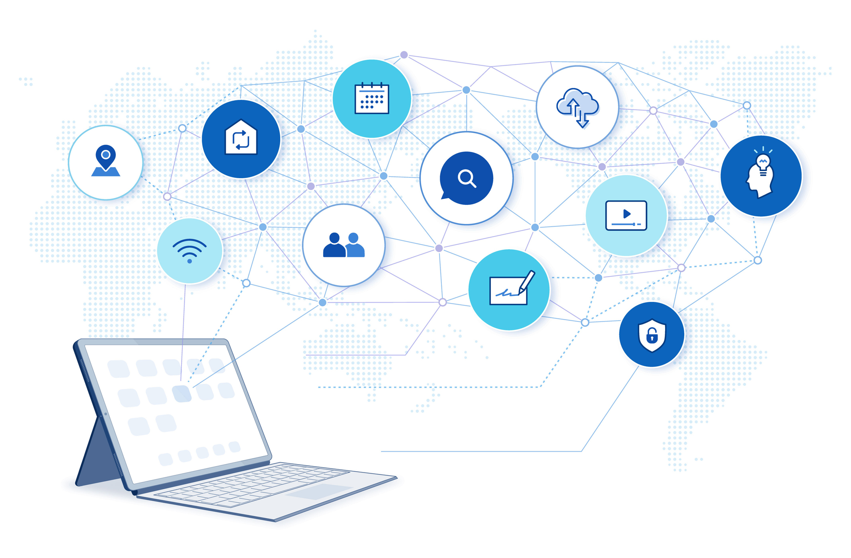
The SEC is a direct-to-consumer (DTC) government agency who utilizes digital and social marketing tools and channels to acquire and engage consumers.
A direct-to-consumer government agency refers to a government body that interacts directly with the public, providing services or information to citizens without necessarily going through intermediaries, essentially treating the citizens as their customers.

Slide 6
Key points about direct-to-consumer government agencies
Examples
Agencies like the Consumer Financial Protection Bureau (CFPB), Federal Trade Commission (FTC), Food and Drug Administration (FDA), and Social Security Administration (SSA) are considered direct-to-consumer, as they directly handle citizen inquiries and complaints related to their respective areas.
Public Interaction
These agencies, like the SEC, have websites, phone lines, and physical offices through which individuals can access information, submit requests, or file complaints.
Focus on Customer Experience
Similar to private companies, direct-to-consumer government agencies strive to improve
the overall experience for citizens by providing clear information, efficient service, and
responsive communication.
Regulatory Role
While interacting directly with consumers, these agencies also have regulatory functions to ensure compliance with relevant laws and standards within their jurisdiction.
Notes:
Light cream or yellow

Slide 7
There are three methods to acquire new customers: paid, owned, and earned media.
Paid Media
Company pays money out of its marketing budget to showcase its products or services. Often called “outbound marketing.”
Owned Media
Company uses owned assets such as its website or social media pages (including blogs, newsletters, and posts) to reach its target audience. Also referred to as “inbound marketing.”
Earned Media
Consumers learn about products/services from other consumers.
Companies often apply SEO to make it easier for the target audience to find content.
This is organic publicity or marketing.
Notes:
Light blue box to cream

Slide 8
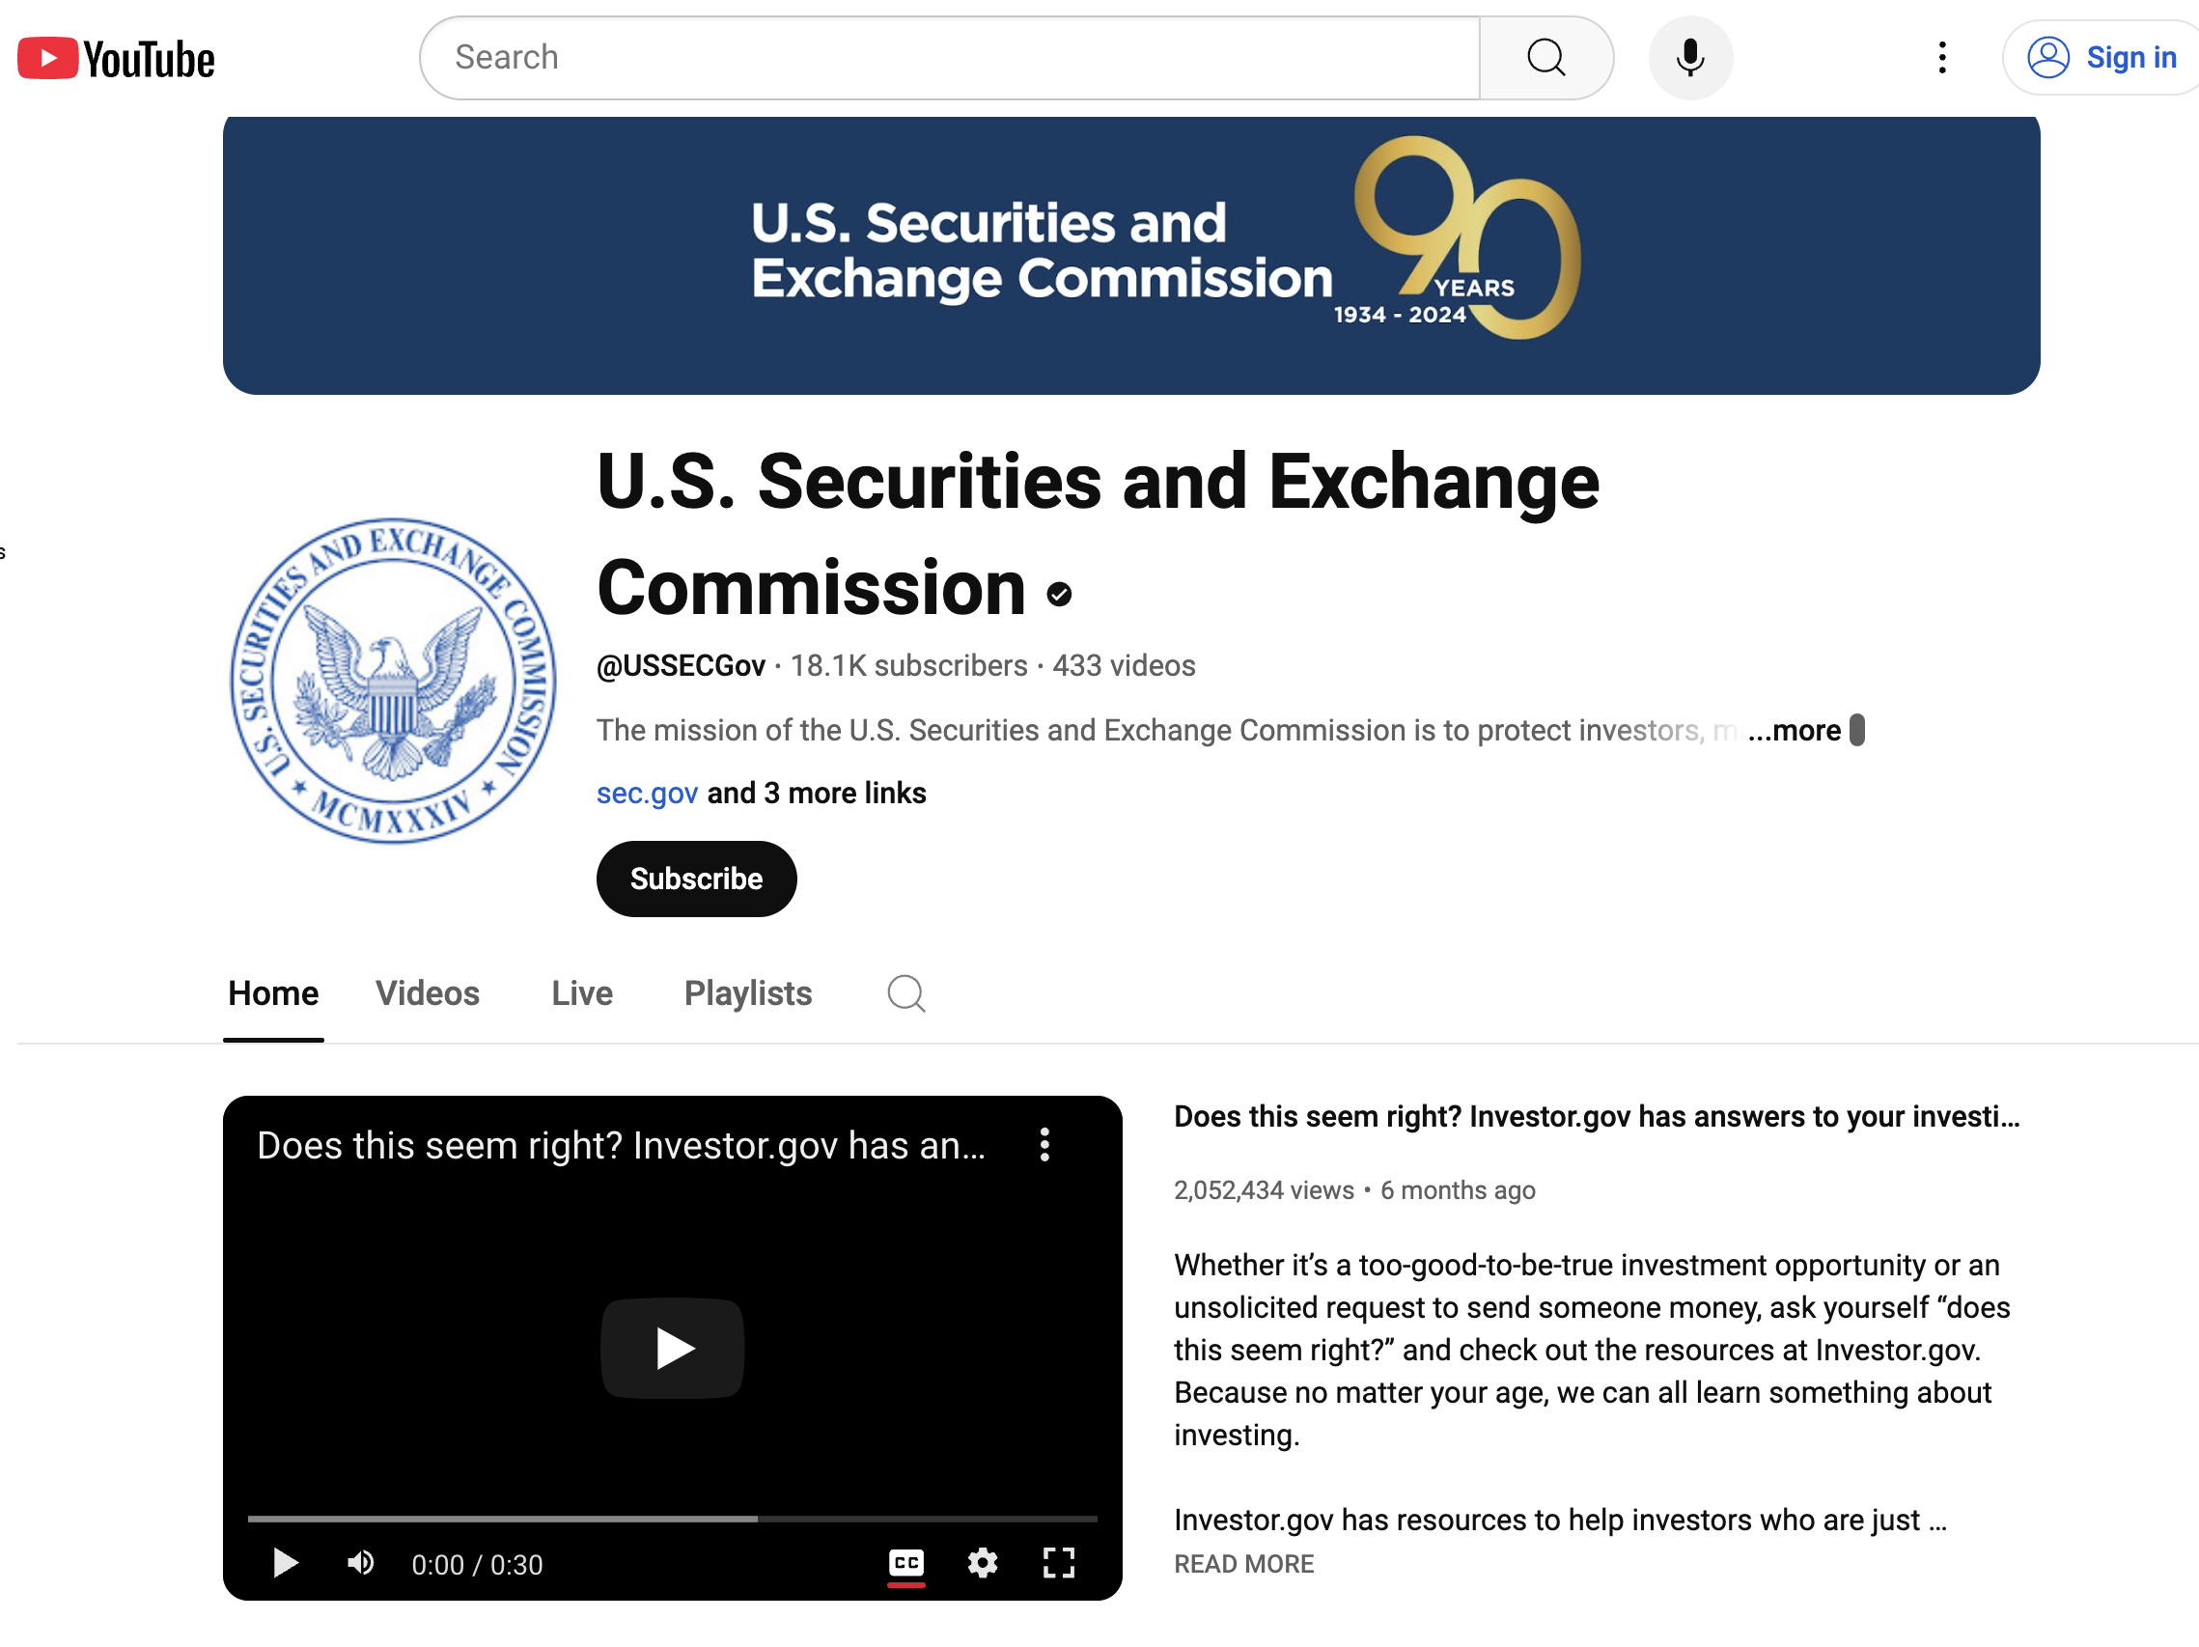
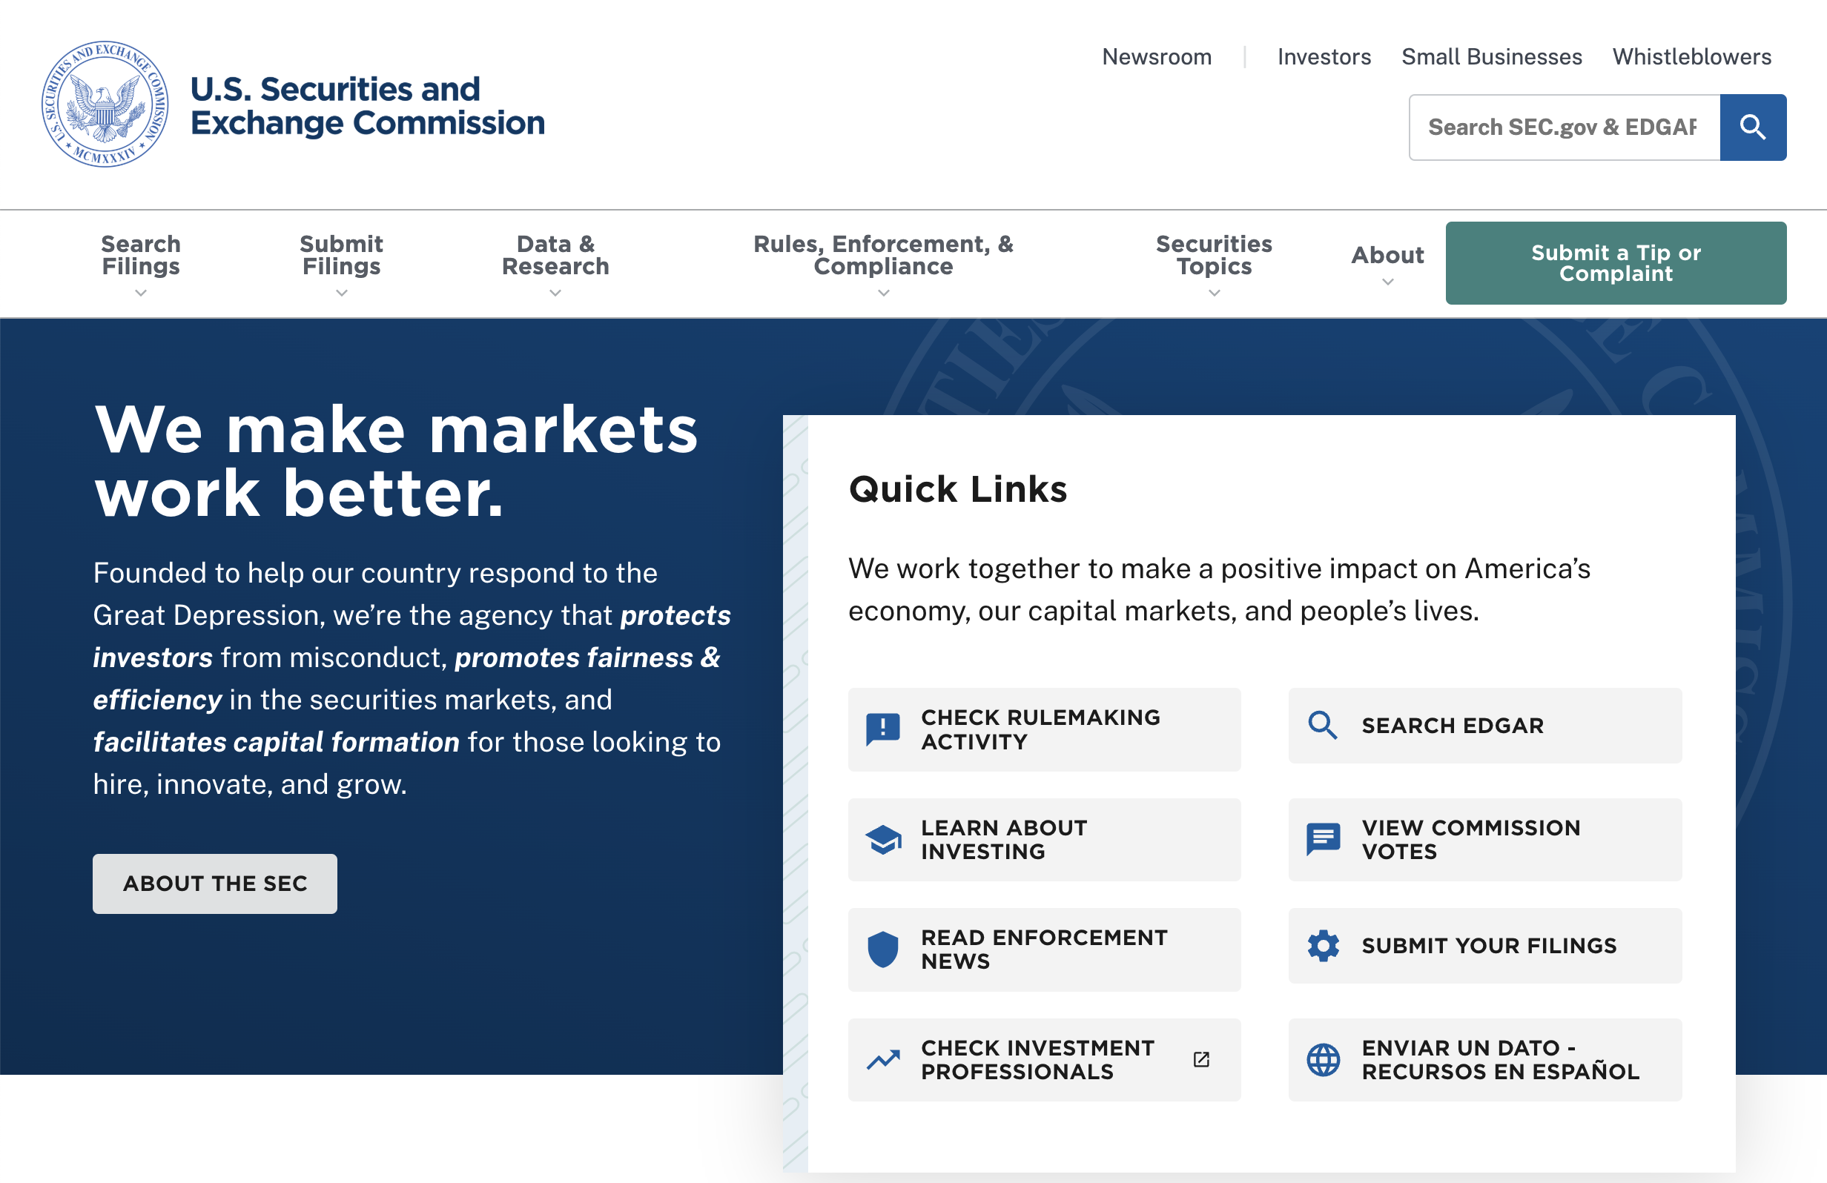
The SEC is a direct-to-consumer agency and utilizes its assets to acquaint consumers with its services. The SEC uses digital owned media assets, including SEC.gov, blogs, and presence on social media channels, and offline owned media assets such as publications, brochures, and newsletters.
Benefits of Owned Media
Provides more control over messaging
Establishes brand tone, look, and feel
Builds deeper relationships with consumers
Works at all stages of the marketing funnel
Allows greater creativity for brand-building
Challenges of Owned Media
Results become apparent only after longer turnaround time
Convincing management that the investment in content creation is worth it

Slide 9
The SEC also benefits from earned media when consumers voluntarily discuss our services, which generates valuable publicity in the process.
BENEFITS OF EARNED MEDIA
Consumers tend to view third-party reviews as more authentic than messages coming directly from companies.
It’s free.
leveraging earned media as a tool for consumer acquisition strategy.
CHALLENGES OF EARNED MEDIA
Earned media comes with a lack of control. Because this form of publicity is generated by external parties, brands ultimately have a less direct role in planning, shaping, and distributing earned media. However, this does not mean that the conversations can’t be steered in the “right” direction.

Slide 10
TECHNICAL OPTIMIZATION
Confirming that the website loads quickly and is easily accessible and readable to search engines.
CONTENT OPTIMIZATION
Ensuring digital content is relevant to what a consumer may be searching for, and is relevant to the brand and business. The right content enhances relevance to a search engine’s algorithm.
LINK OPTIMIZATION
Encouraging other websites to link to the company’s website to gain authority.
Search engine optimization (SEO) is one of the most important tools used to increase discovery of, and engagement with, the SEC. There are three pillars of SEO.

Slide 11
A successful marketing strategy creates long-term value for both customers and companies.
Key Drivers of Customer Lifetime Value
CUSTOMER ACQUISITION
Strategically acquire consumers within your target audience and looks for opportunities to expand into other markets.
CUSTOMER RETENTION
Provide what you promise—
and more. Keep content fresh
and relevant.
CUSTOMER DEVELOPMENT
Continually add and improve on new products and services.
Notes:
Light blue to cream. Add white line around boxes

Slide 12
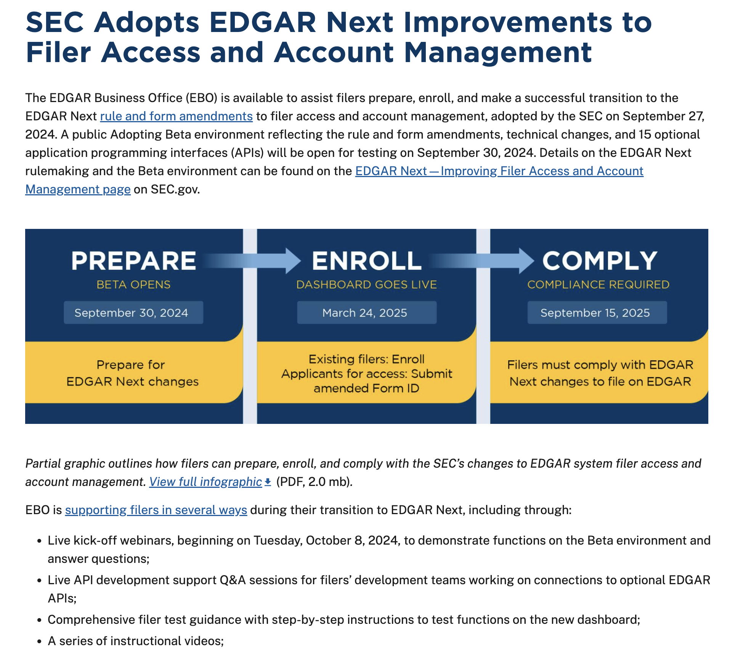
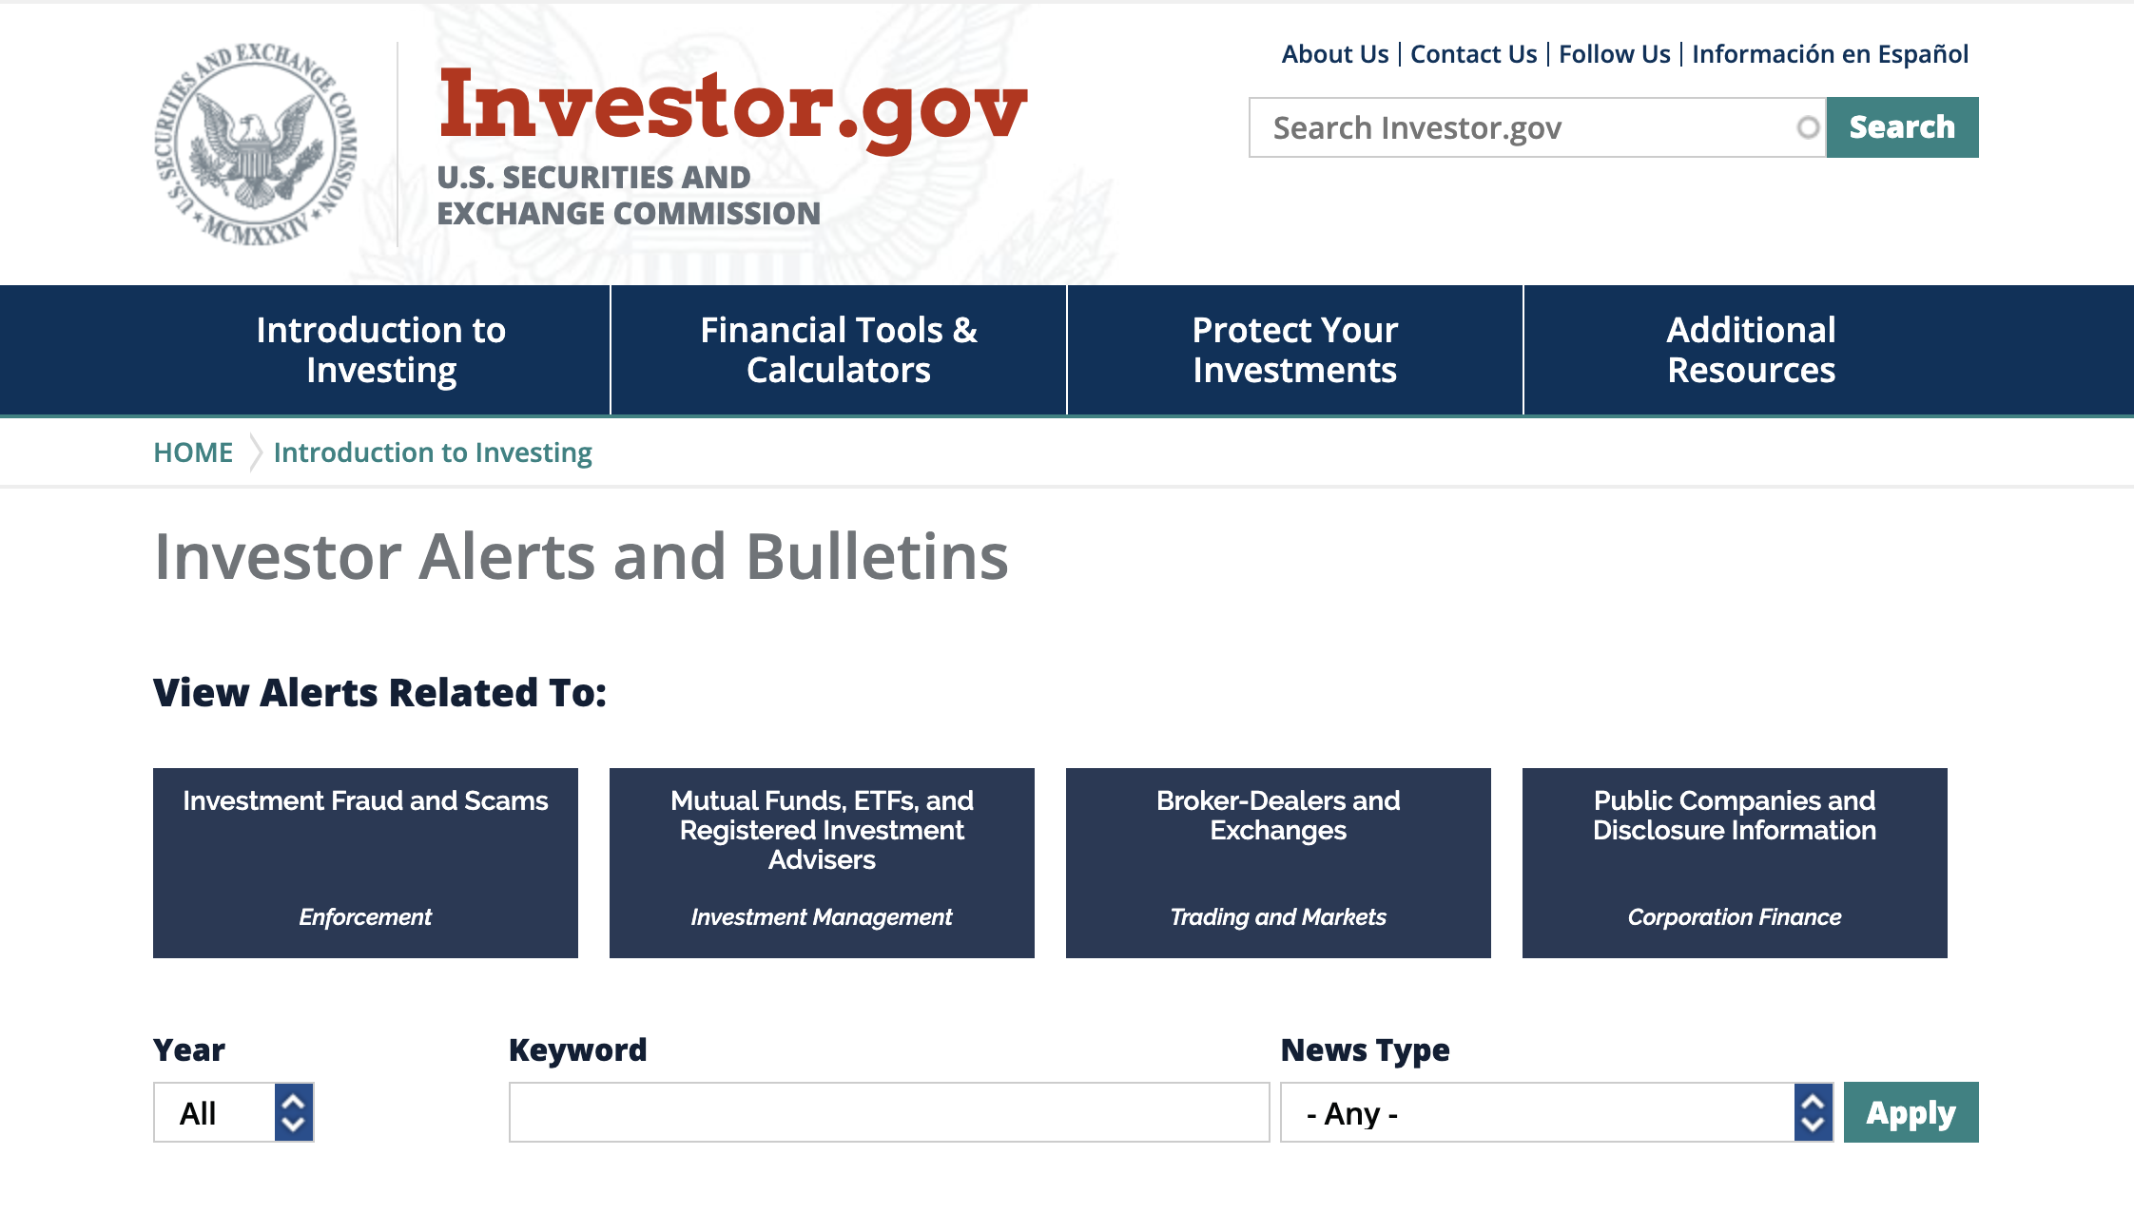
The SEC offers a variety of free services and tools, including:
Access to registration statements, financial reports, and other securities forms through EDGAR
Investor alerts and bulletins
A website to check investment professionals
By developing sound digital marketing strategies that optimize the SEC’s owned media assets, e.g., SEC.gov, Investor.gov, social media pages, newsletters, and brochures, we can continue to help investors avoid fraud and make wise investments.

