Slide 1

AMDA Call Center Training
Initial Contact Call
Purpose of the Initial Contact Call
Intro • Body • Close

Slide 2
How to Increase Show Rates at Auditions
Sell AMDA, not the audition/application - AMDA is the best college in the world to train performing artist. Once students realize how incredible the training and performing opportunities are; they will be desperate to audition for AMDA. If you put the focus on the audition you will scare them. If you put the focus on AMDA you will excite them
Have the AMDA website up, interchange listening with providing information

Slide 3


Slide 4
Screen in, not out
Refrain from pre-screening. Book everyone that is interested in applying and auditioning for AMDA regardless of what your perception of their skill set is. This is a time tested process. If the student isn’t qualified for the school, then the audition will identify that.
  “We are scheduling auditions for the LA campus on Saturday December 4th, 2016 are you available to attend?”
  “Your background and training sound great and you’re invited to audition in Los Angeles on ___________________________”

Slide 5
You’re doing what?
Equip prospective students with the “why AMDA” so they can share that “why” with their support team
  There are many parents that do not understand performing arts majors or performing arts as a career. Equip students with information that they can pass on to their family so that their parents, and friends support them to the audition versus talking them out of auditioning.
    “Are your parents supportive of your desire to major in performing arts?”
    (Notice this question does not mention studying at AMDA)
      “If yes move on, if no ask why”
Once you know the “why”, use AMDA facts to equip the student to overcome the objection, because they will need to do that with their support team.
  “My mom doesn’t understand how performers get work”
  “That’s a common question. AMDA trains it’s students on how to not only book work as a performer but also to create work as an entrepreneur through our industry and networking courses.” You will learn practical business skills that will benefit you to work in the industry when you are between performance projects.”

Slide 6


Slide 7
About AMDA
Celebrating more than 50 years as one of America’s premier conservatories for the performing arts, AMDA is recognized throughout the industry for its rich history and tradition of launching some of the most successful careers in theatre, film and television.
In 2003, the Martins brought AMDA’s success to the golden West Coast, founding a Los Angeles campus in the Art Deco Yucca Vine Tower located in the heart of Hollywood
AMDA became the only Bachelor of Fine Arts Degree-granting performing arts institution with campuses in both New York and Los Angeles.
Each year, more than 1,400 students engage in AMDA’s rigorous curricula, each young artist training under the guidance of our faculty of professional artists and instructors at the leading edge of their respective fields
AMDA is committed to providing an unsurpassed performing arts education to a diverse community of creative artists. AMDA serves as both school and stage, where students are given the support and opportunity to define their own personal objectives and to develop and refine their own distinctive artistic voices.

Slide 8


Slide 9
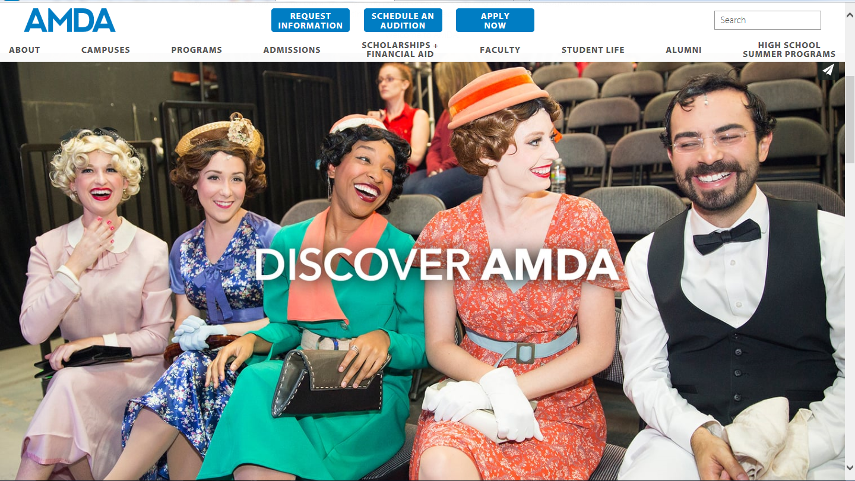
Tools of the trade
Have the AMDA website up, and interchange listening with providing information.

Slide 10


Slide 11
Script Review
Intro - To inform students or parents the purpose of the call and to build rapport
Body - To gain information about the student’s interest in attending a performing arts college, and to identify some information regarding their background and training
Close - To answer questions and to schedule the audition
Final Thoughts: This call should not exceed more than 15 minutes (Even with several questions being answered. Remember this is one initial stop on the enrollment path, and it’s important that our prospective students take the “scenic route”

Slide 12


